Slide 1
Team 3: Curie Head
Rob Holt
David Yakovlev

Slide 2
Project Summary
Repair Curie Head
Skull broken
Latex ripped
Several other repairs detailed later
Verify physical components are in working order and understand computational platform
Develop code base to allow easy inclusion of new gestures

Slide 3
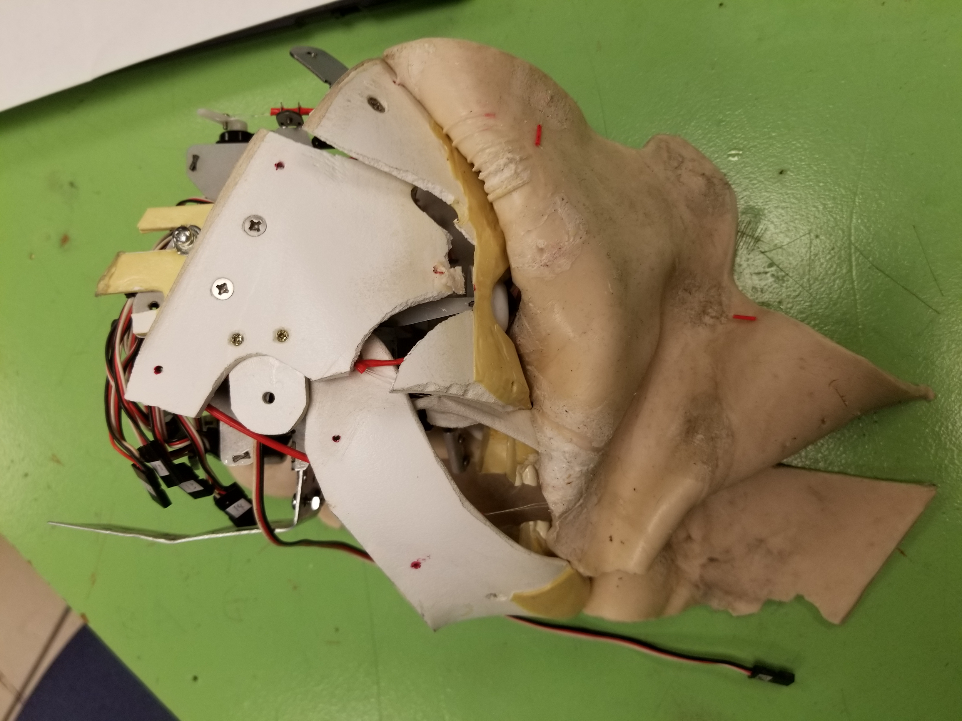
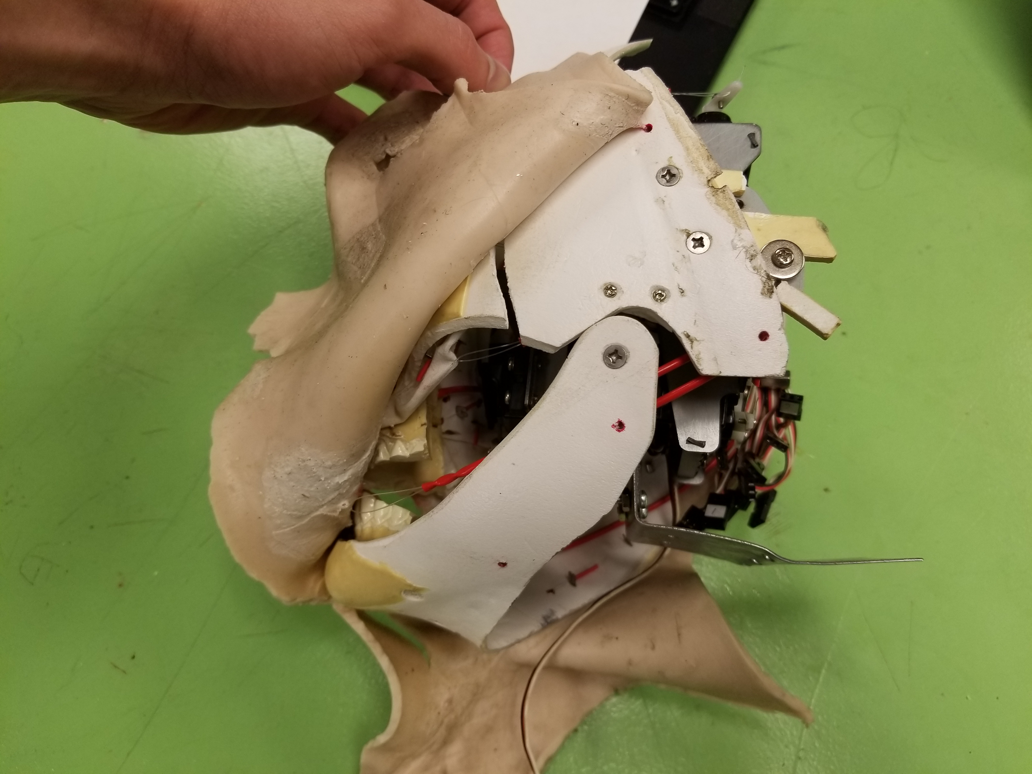
Skull Repair

Slide 4
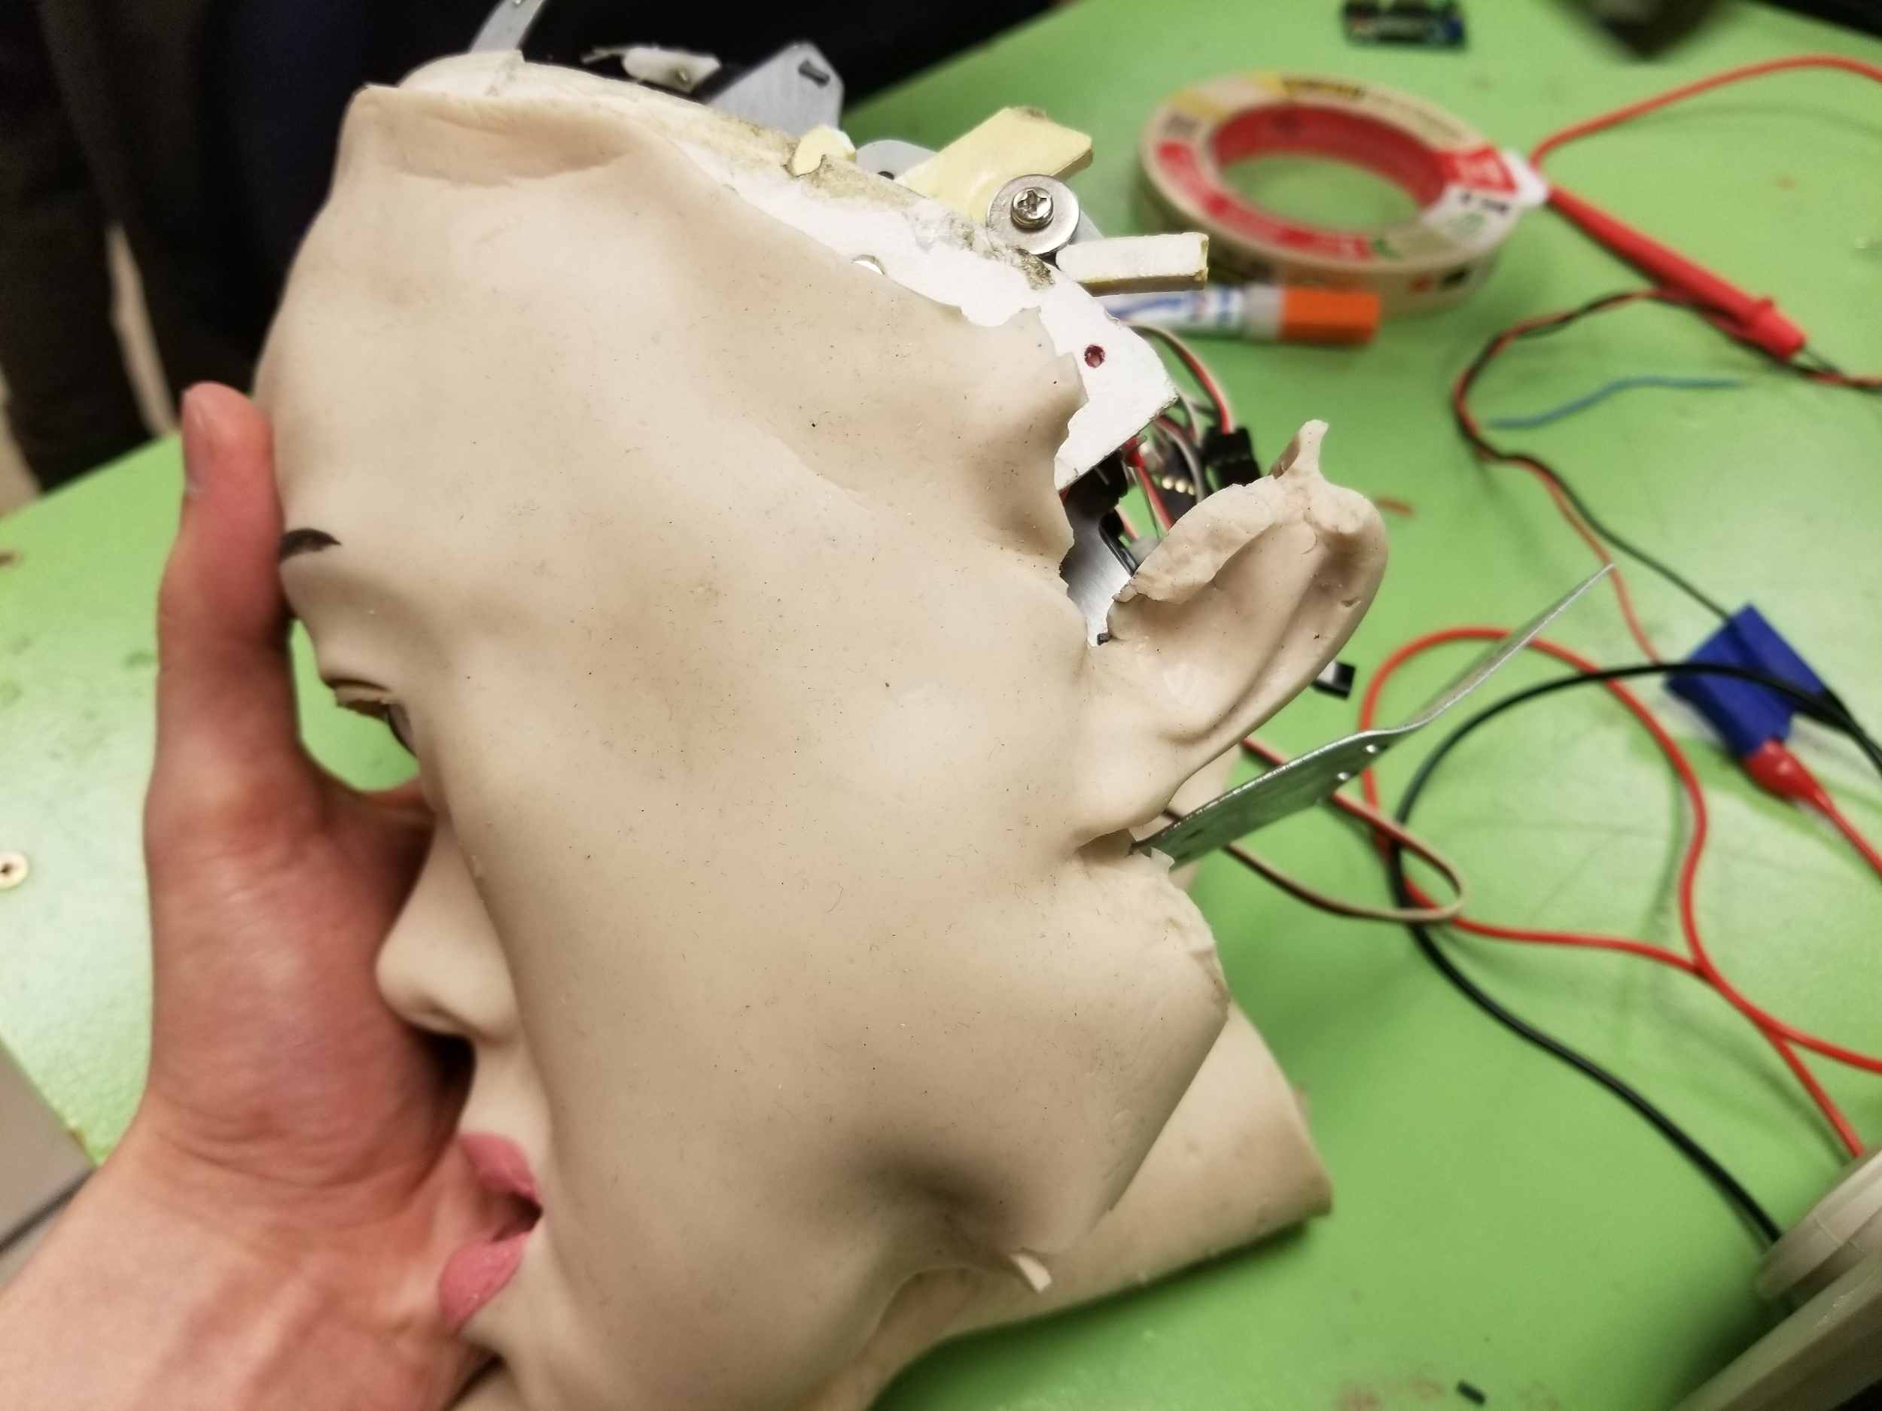
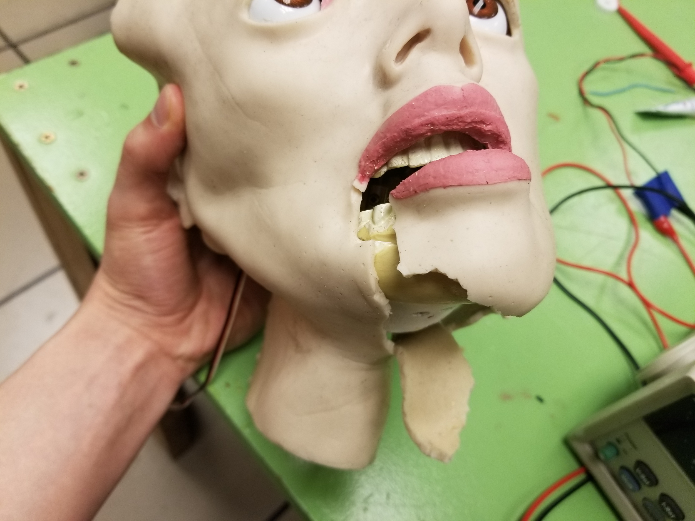
Latex Repair (1 of 2)

Slide 5
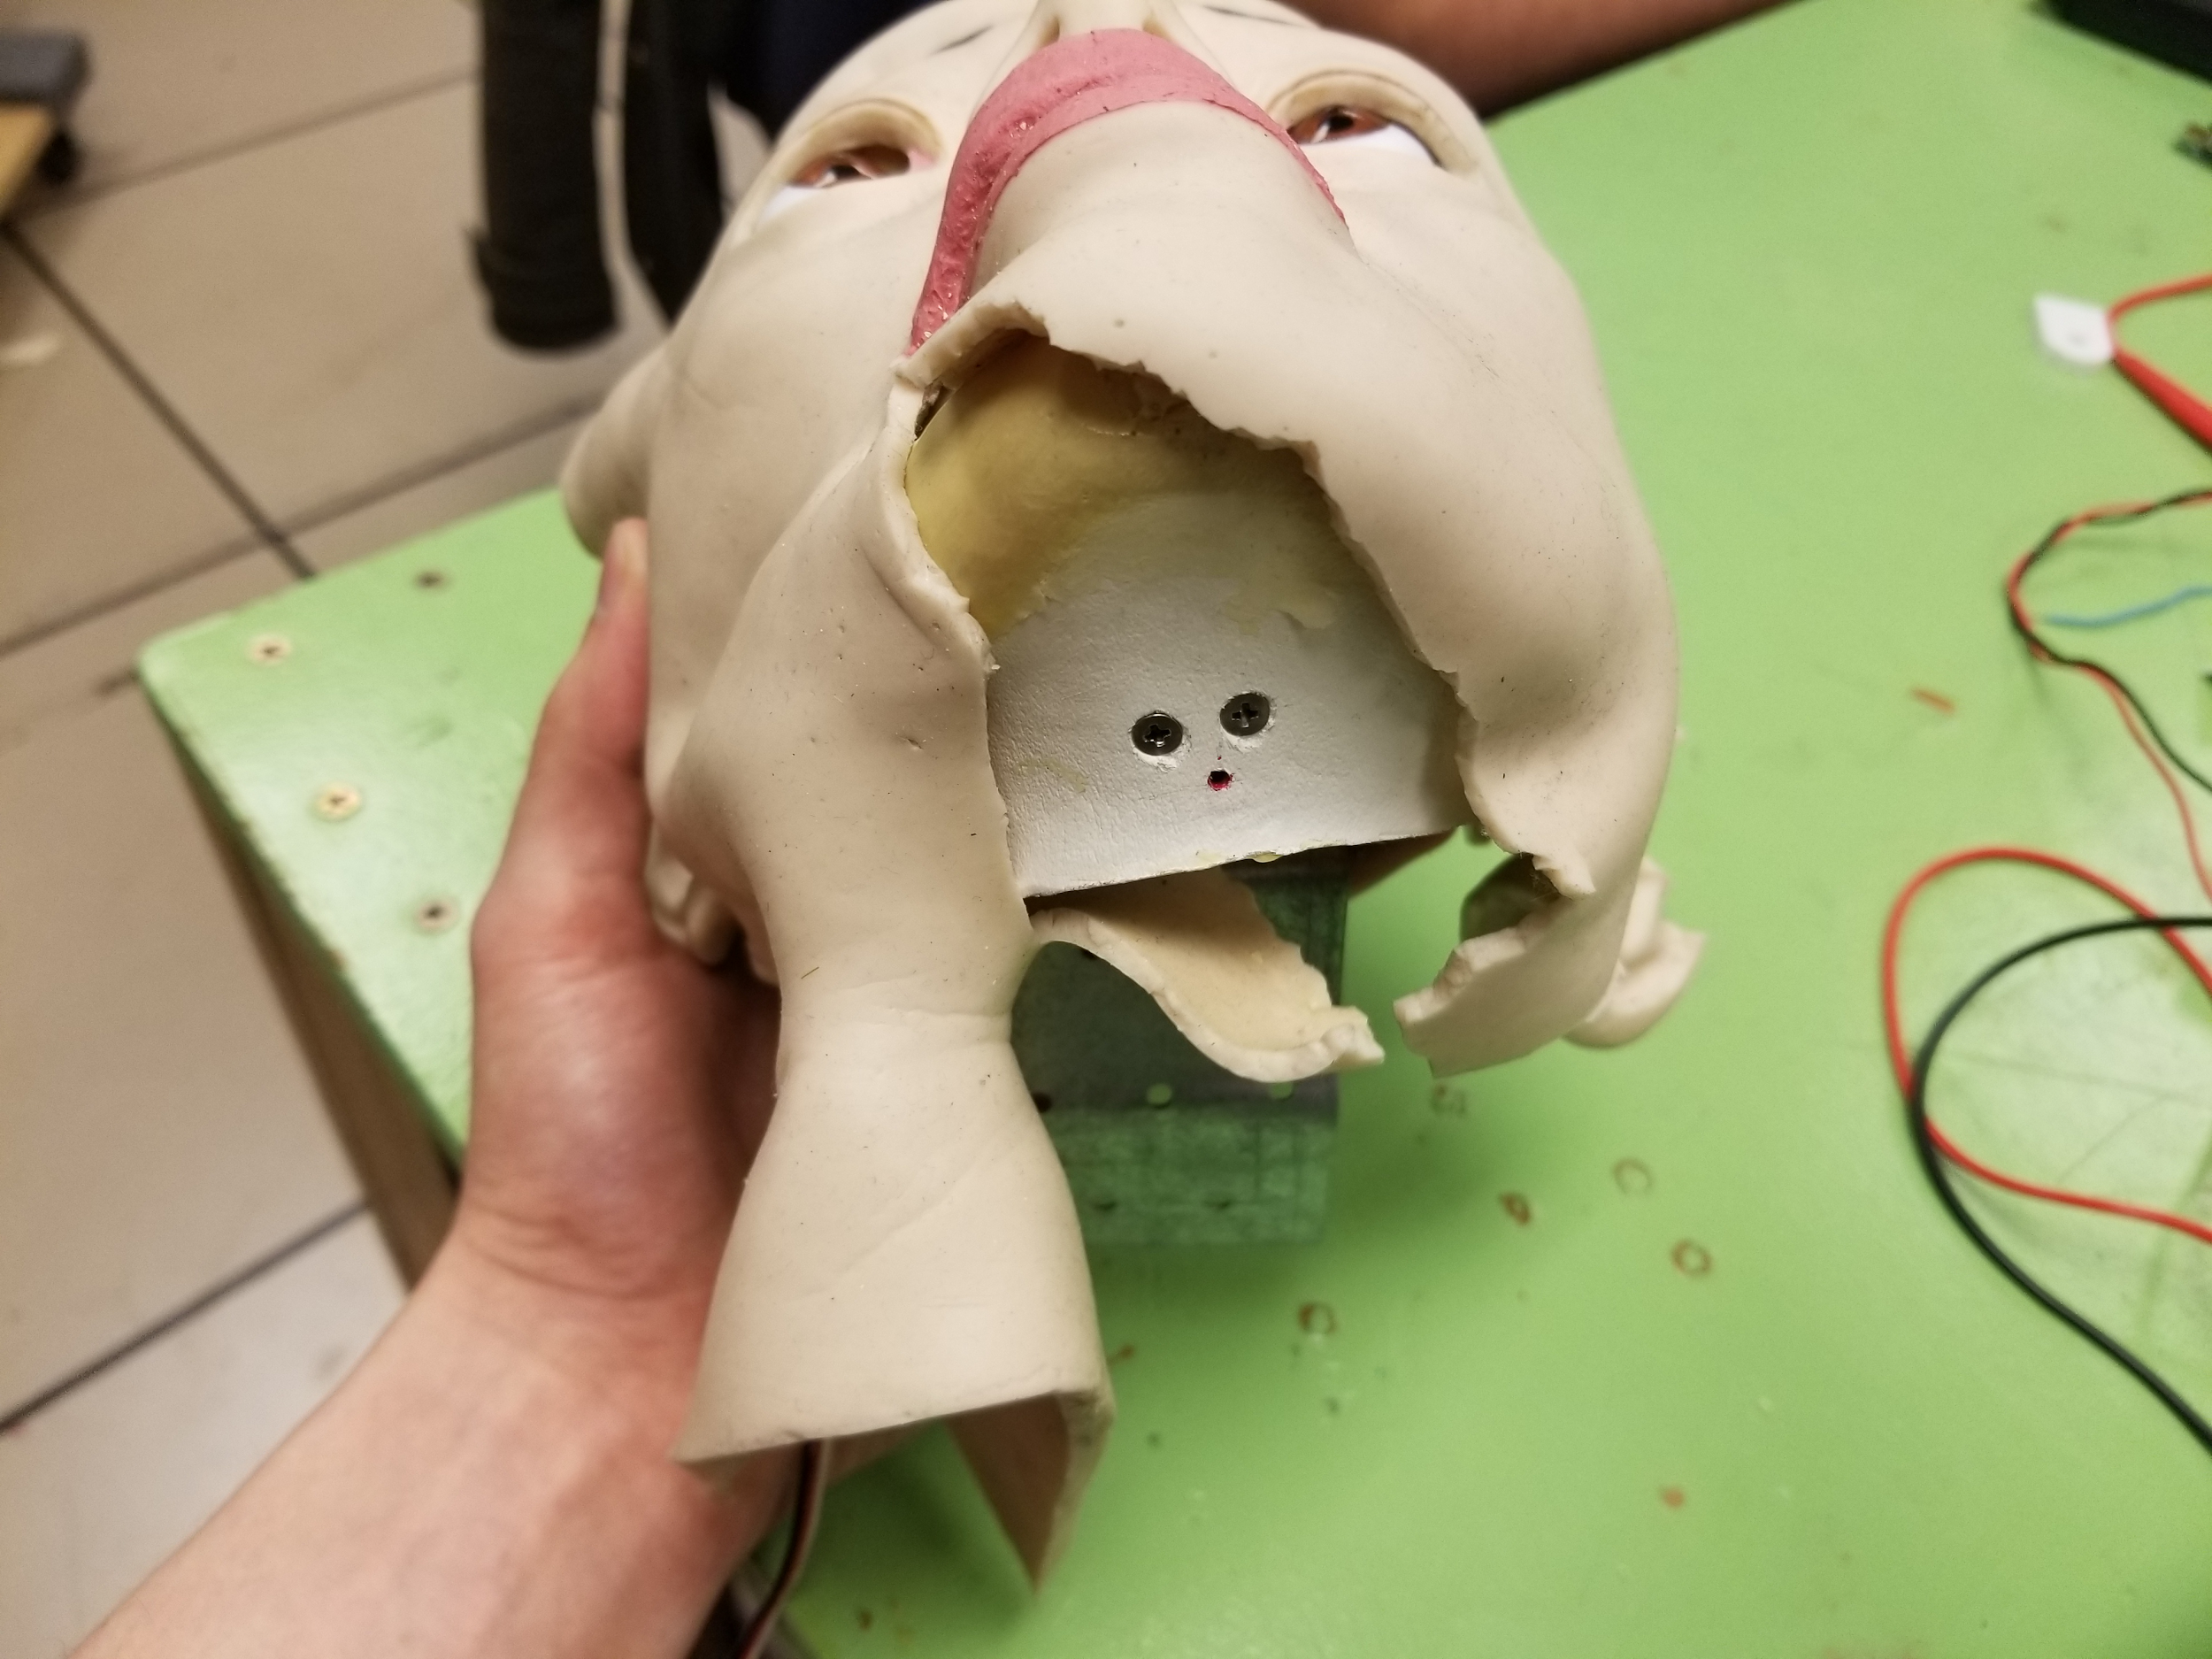
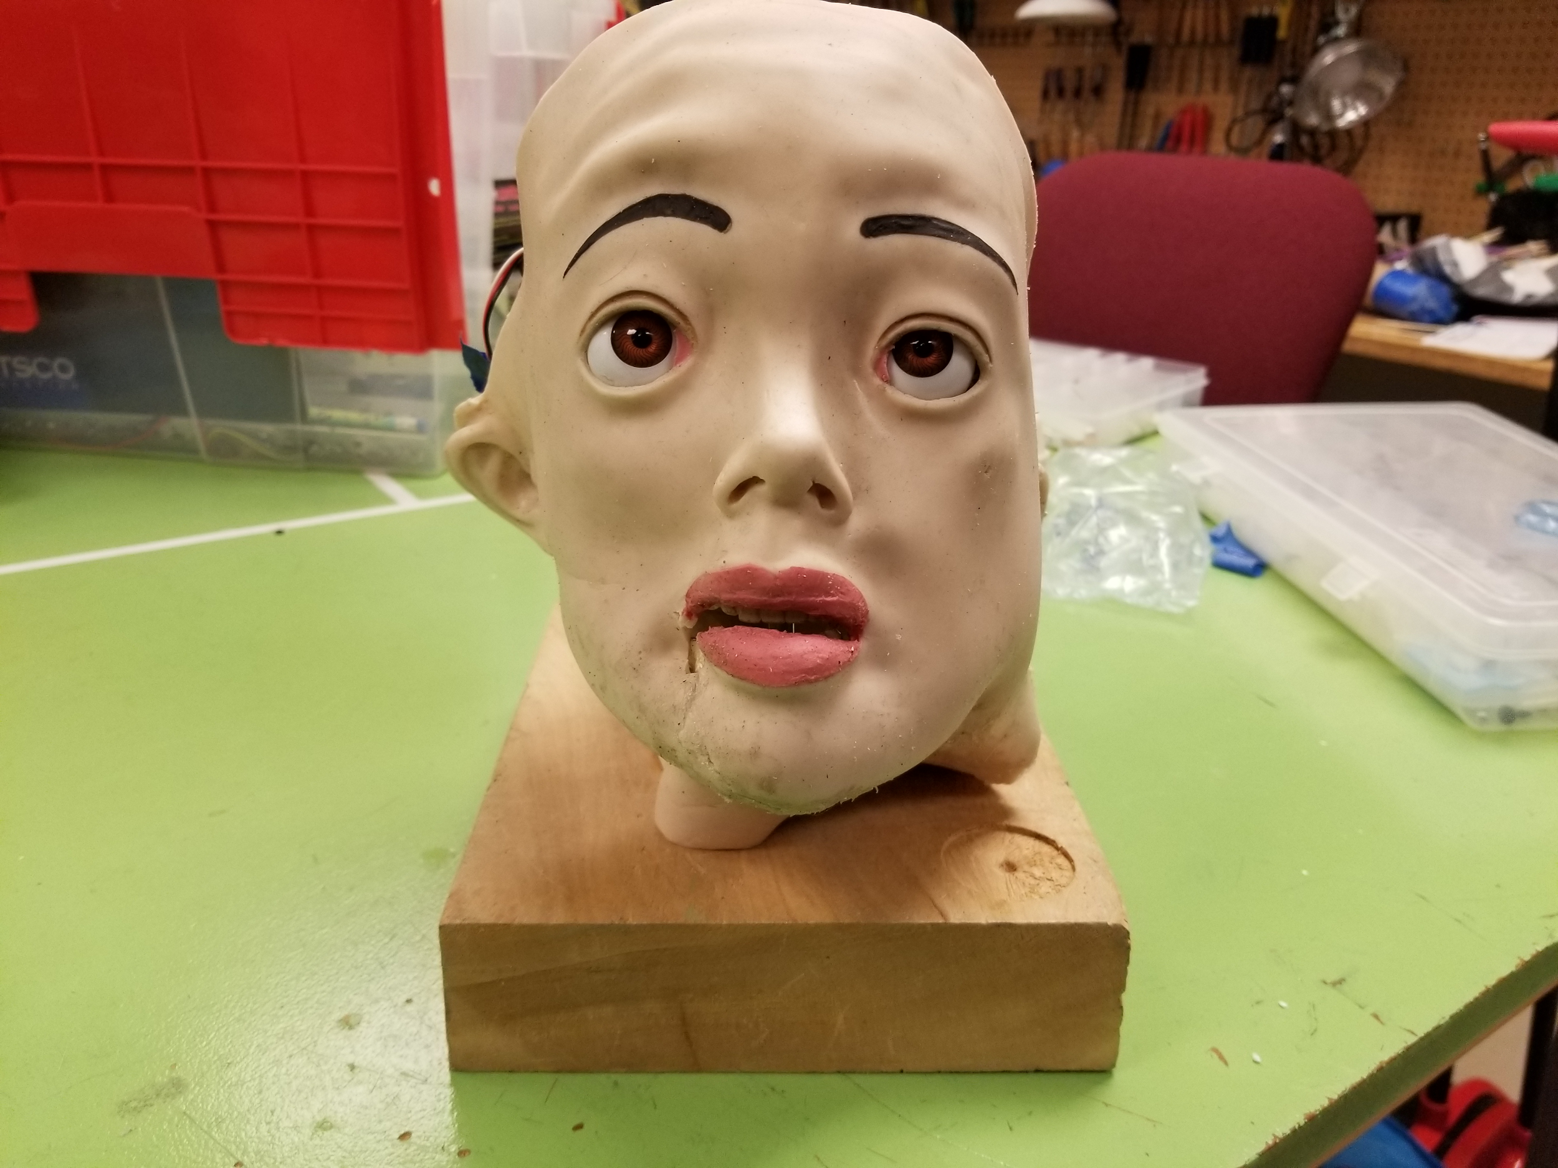
Latex Repair (2 of 2)

Slide 6
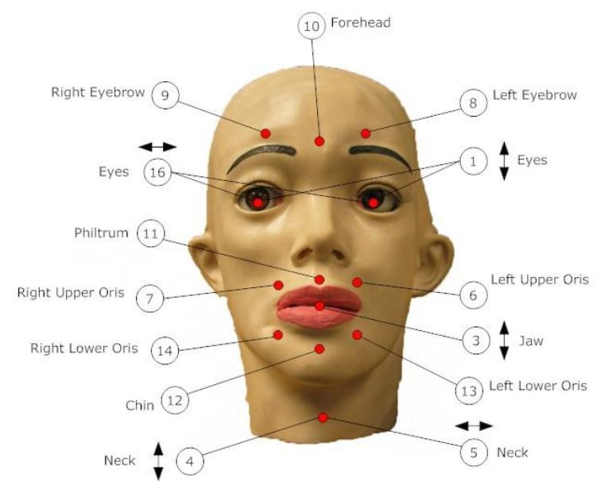
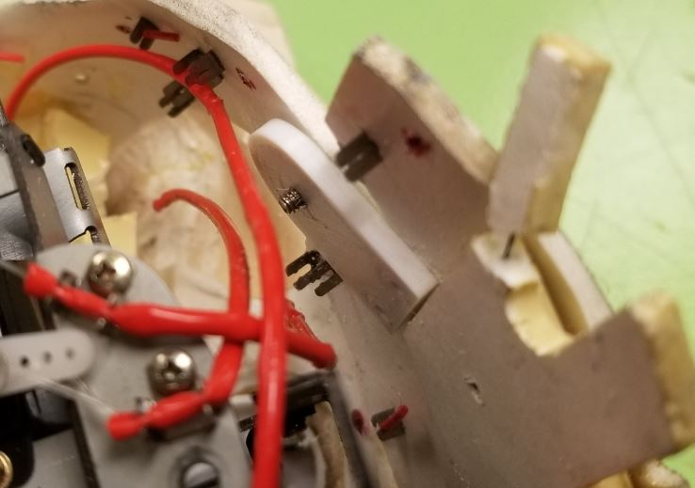
Other Repairs
2 Servos replaced
Jaw joint linked to servo
Jaw to Skull attachment
Tensioning servo strings to latex
Re-attach fabric to skin for full oris control
Acquired new servo controller board

Slide 7
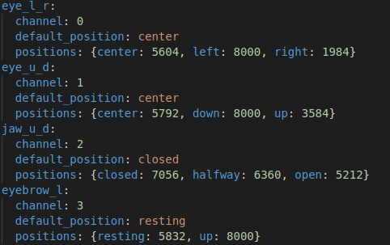
Expression and Gesture Framework
Desired easy framework for addition of new expressions and gestures
Needed to reduce complexity from past projects which included Powerpoint presentation, Python, Arduino, obscure protocols.
Desired semantic and logical abstractions for servo control and positions
New semantic values can be added simply via YAML to an existing text file.

Slide 8
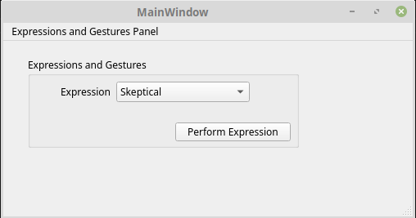
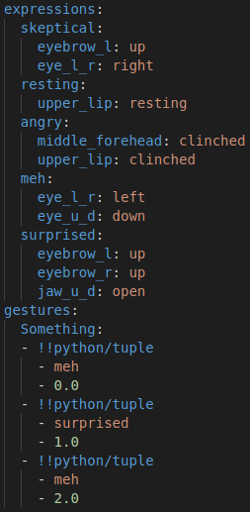
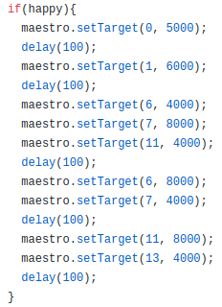
Expression and Gesture Framework (Cont.)
GUI largely unnecessary but allows for simple testing of created expressions.
GUI can be extended (if there is interest) to allow individual servos to be set to semantic positions.

Slide 9
Next Steps ...
Continue with implementing elegant gesture (expressions coordinated in time). Concept in place, implementation next.
Looking for guidance on requests in initial project definition
Gender recognition using webcam + OpenCV per request in project description?
Mouth synchronizations with audio using Amazon Polly and speech marks?

Slide 10
Demo

